Slide 1
Collaborative Platform Version 5.0
Team Members
Product Owner
Adrian Alfonso
Juan Caraballo
Jorge Travieso

Slide 2
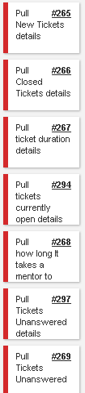
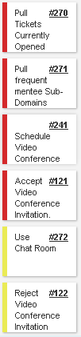
Sprint 4 Stories
Total 72 pts

Slide 3
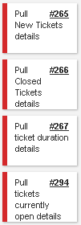
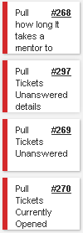

My Sprint 4 Stories (Total 40 pts)
Week 1 Stories completed
Week 2 Stories completed

Slide 4
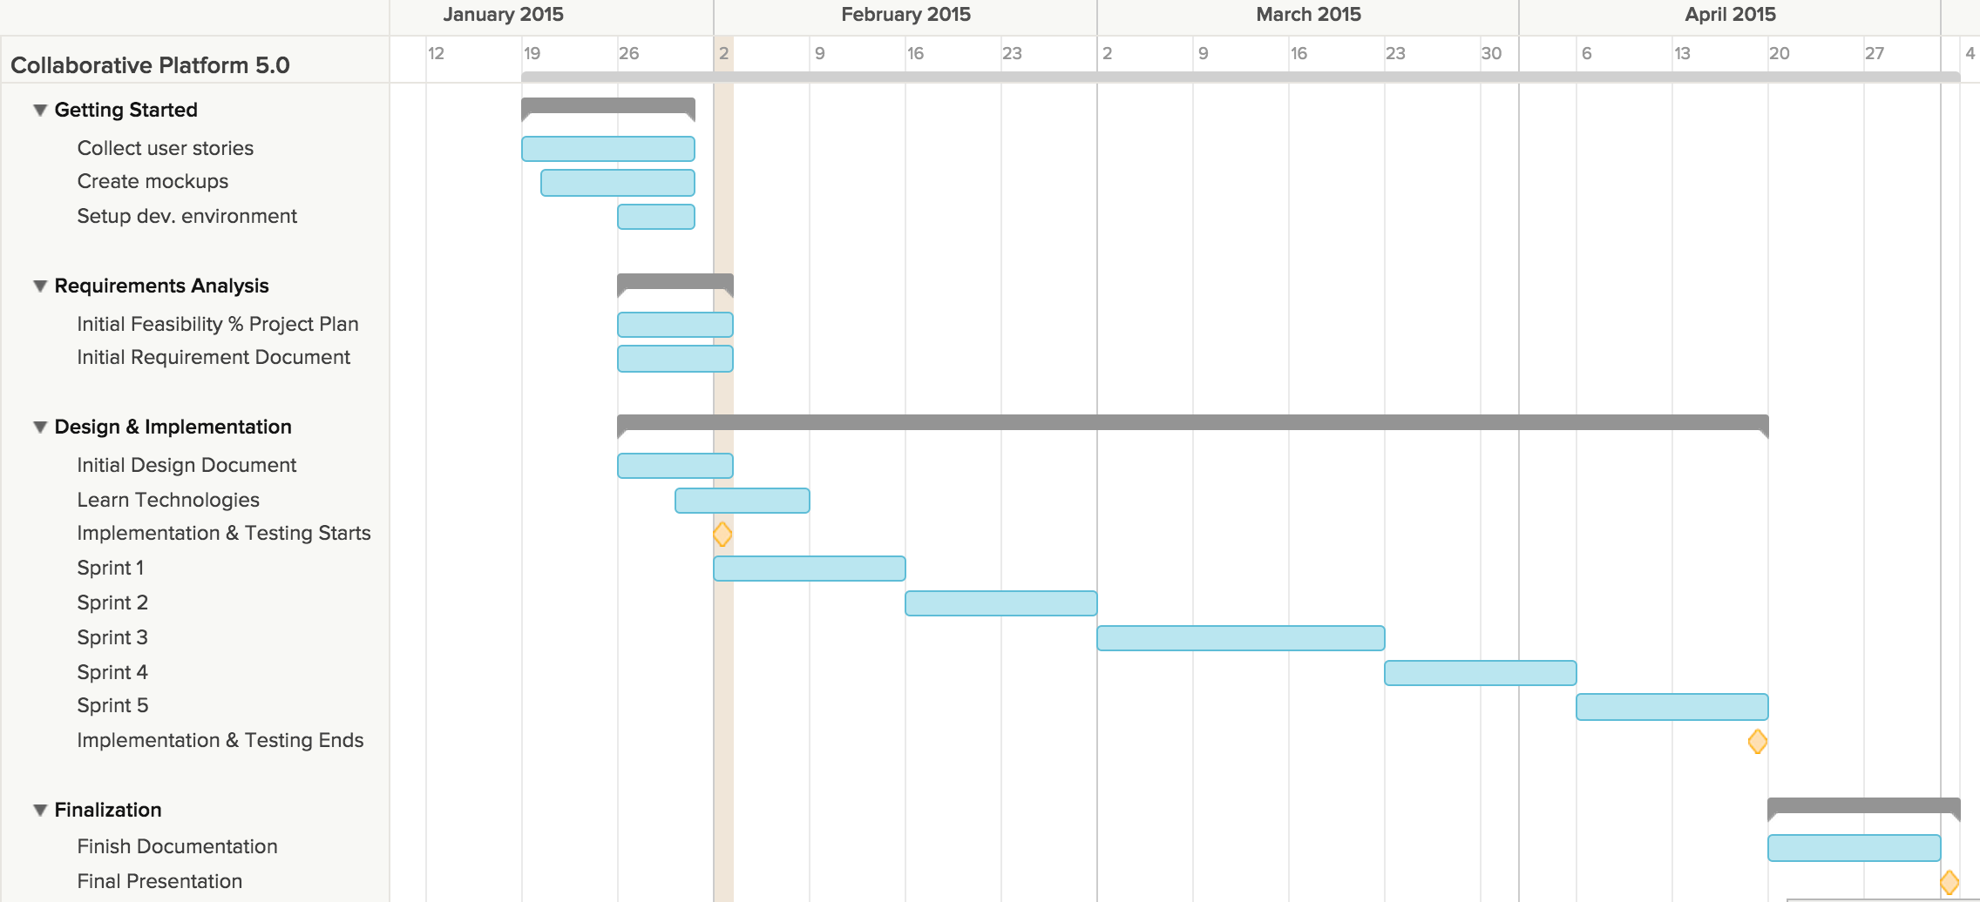
Project plan

Slide 5
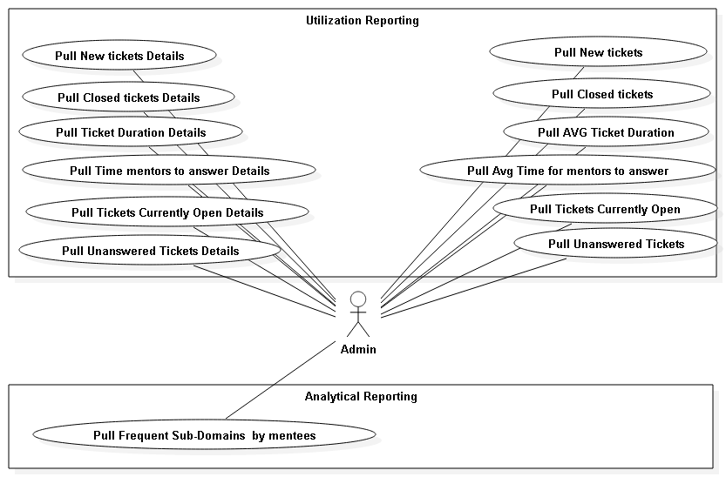
Use Cases

Slide 6
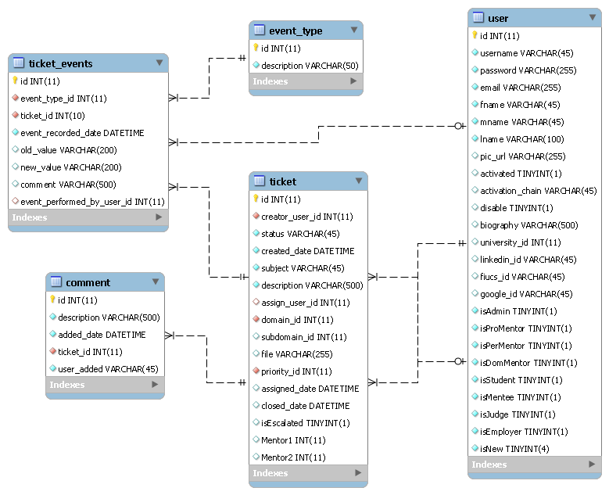
ER Diagram

Slide 7
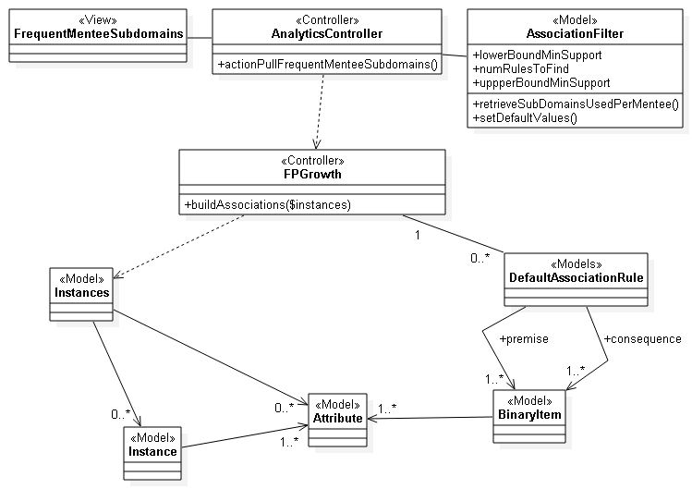
Class Diagram (Frequent Sub-Domains...)

Slide 8
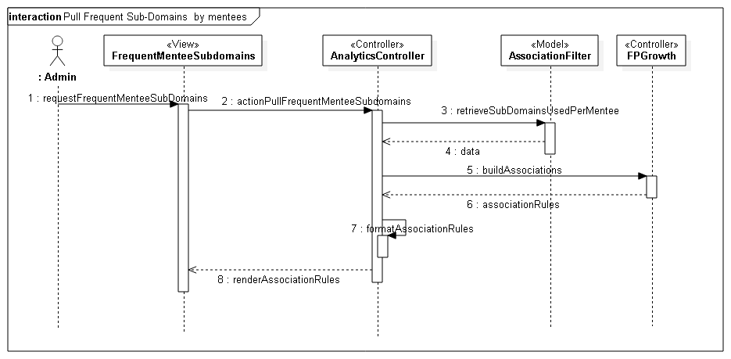
Sequence Diagram (Frequent Sub-Domains...)

Slide 9
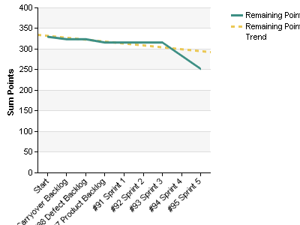
Burndown chart

Slide 10
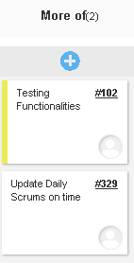
Retrospective

Slide 11
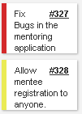
Sprint 5 Stories
Total 32 pts

